Slide 1
Portscanner

Slide 2
Aim of project
Implement a portscanner in C
Various scan methods e.g. TCP connect scan, TCP SYN scan …
Console program like nmap

Slide 3
Implemented Scan Methods
TCP connect scan
TCP syn scan
NULL scan
XMAS scan
FIN scan
Maimon scan

Slide 4
Implementation
SOCK_STREAM socket (TCP socket)
Use connect() function to try to establish a connection with the target machine
Check return value of connect() function
Return value 0 = port is open, else port closed

Slide 5
TCP connect scan
Simple approach
Use system call connect() to try to establish a connection
If connection successful port is open
Else port is closed

Slide 6
Implementation
SOCK_STREAM socket (TCP socket)
Use connect() function to try to establish a connection with the target machine
Check return value of connect() function
Return value 0 = port is open, else port closed

Slide 7
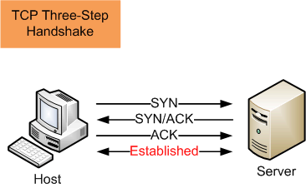
TCP Handshake

Slide 8
Syn scan

Slide 9
Raw socket

Slide 10
Implementation

